Slide 1
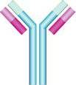
Immunology Biol 465 Minot State University Spring 2020
MWF 9-9:50 am
Lab Tuesdays 9am-noon

Slide 2
Lecture 23-Part 1 For March 27th , 2020
Announcement-
Quiz 4--Tuesday—March 31st---During our regular lab time. The quiz will be available 9 am –10:30 am.
Plan appropriately to start on time to finish.
I can do another Blackboard collaborate session Monday for questions.
Topics list—Will be attached to website—this weekend.

Slide 3
Where were we?
MHC restriction—define
Alloreactivity—in allogeneic transplants
Tissue rejection
Finding a close MHC “match”
Syngeneic transplants
Signal transduction—Chapter 7

Slide 4
Moving on…
Chapter 7 introduces us to a set of universally important cellular process known as Signal Transduction.
We have already had to think about signal transduction to a certain extent in our discussions of innate immunity.

Slide 5
For example…
When cells of the liver bind to IL-6, it signals the liver cells to change it’s genetic program. Liver cells start expressing genes that encode the acute phase proteins.

Slide 6
We will stick to general principles and avoid memorizing specific pathways for now.
There are common aspects to all signal transduction pathways..
1. The signal comes from outside the cell
2. Transmembrane receptors facilitate movement of the initial signal from outside to inside. (The final destination is the nucleus)

Slide 7
3. Proteins in the cytoplasm in turn pass on the signal that the cell received from the receptor.
4. New genes are turned on and/or current gene expression is turned off.
The new proteins elicit a specific new activity for the cell or allow other cells to so something they didn’t do before.

Slide 8
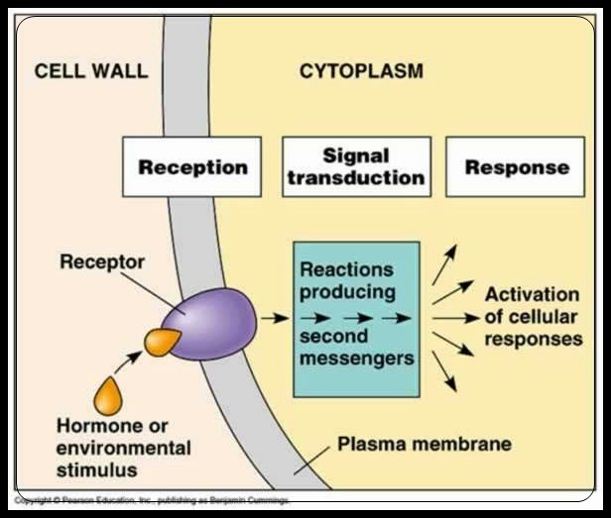
Signal Transduction---the basics and specific immunological pathways
Cytokine

Slide 9
Good summary—Janeway text
https://www.ncbi.nlm.nih.gov/books/NBK27151/

Slide 10
Passing the signal…
How? Is there a common mechanism?
Yes---to a large extent the “movement” of the signal from out to in is facilitated by protein alterations known as phosphorylation and de-phosphorylation.
Proteins can be phosphorylated (linked to a phosphate group) on 3 different amino acids.
tyrosine, serine, and threonine

Slide 11
2 types of enzymes catalyze these alteration
Kinases add phosphates (there are tyrosine kinases and serine/threonine kinases)
Phosphatases remove phosphates from proteins.

Slide 12
Figure 1 shows just two examples of early events in signal transduction.
We can walk through the figure.

Slide 13
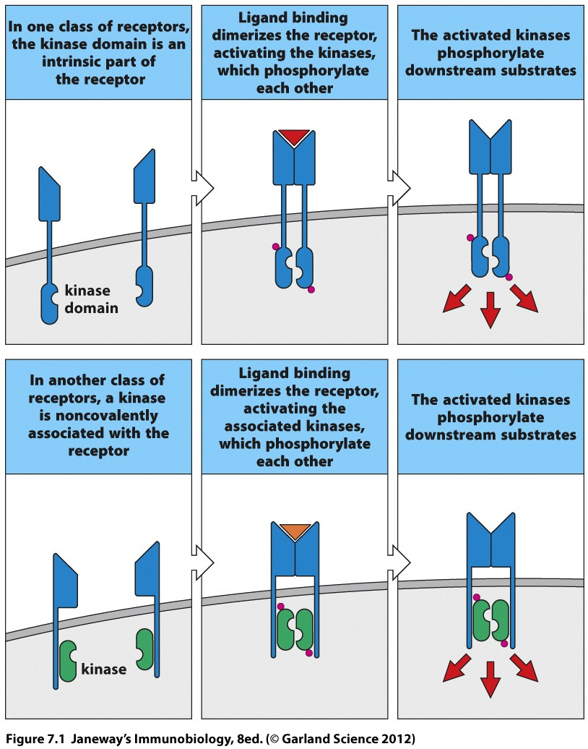

Slide 14
Signal transduction requires a large number of proteins “talk” to one another in sequence.
There are specific parts of each protein that interact in this “talk”. They are called protein- interaction domains. Among the most common are domains known as SH2 and SH3 (src homology) domains.

Slide 15
SH2 domains are regions for binding of other proteins and the protein-protein interaction occurs via a phosphorylated tyrosine.
When a protein is described as having an SH2 domain, you can be sure it interacts with another phosphorylated protein in signal transduction.

Slide 16
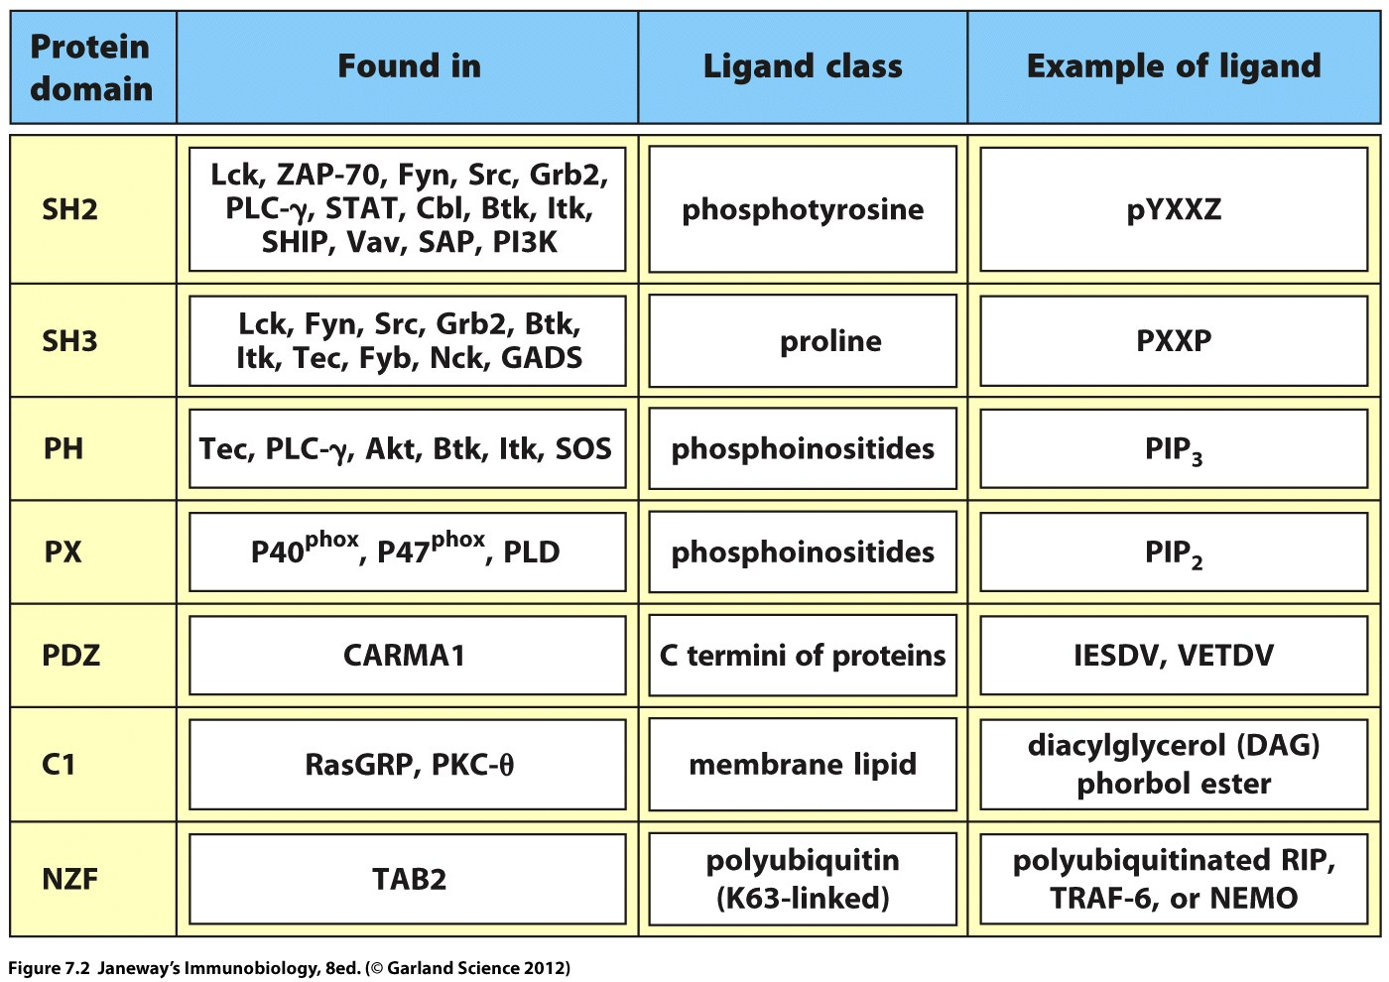

Slide 17
General example
The protein is activated by phosphorylation on Tyrosine, which changes the shape of the protein---allowing it to do a new activity….

Slide 18
Cytokine signaling animation
https://www.youtube.com/watch?v=drLNeu4Jhdg

Slide 19
As the signal (such as a signal initiated by binding of a cytokine) moves inward the proteins continue to interact---at times piling up in succession.
Some of the proteins function solely to recruit others to the signal path. Adaptors and scaffold proteins function this way. They have no enzyme activity themselves but bring together other proteins like kinases and phosphatases.

Slide 20
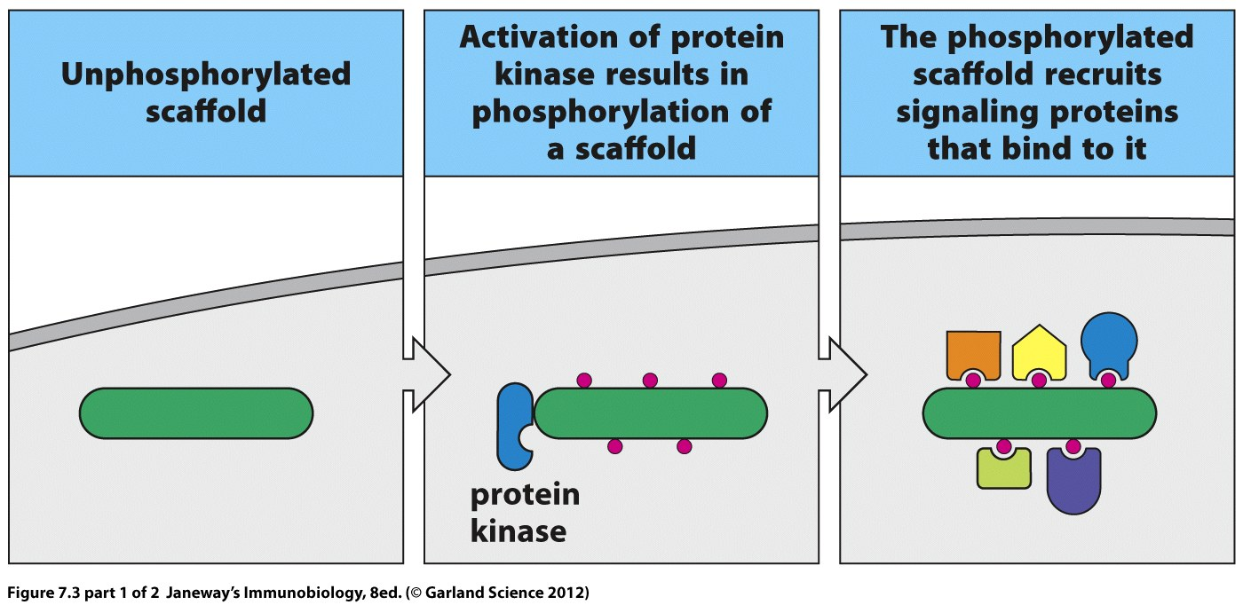

Slide 21
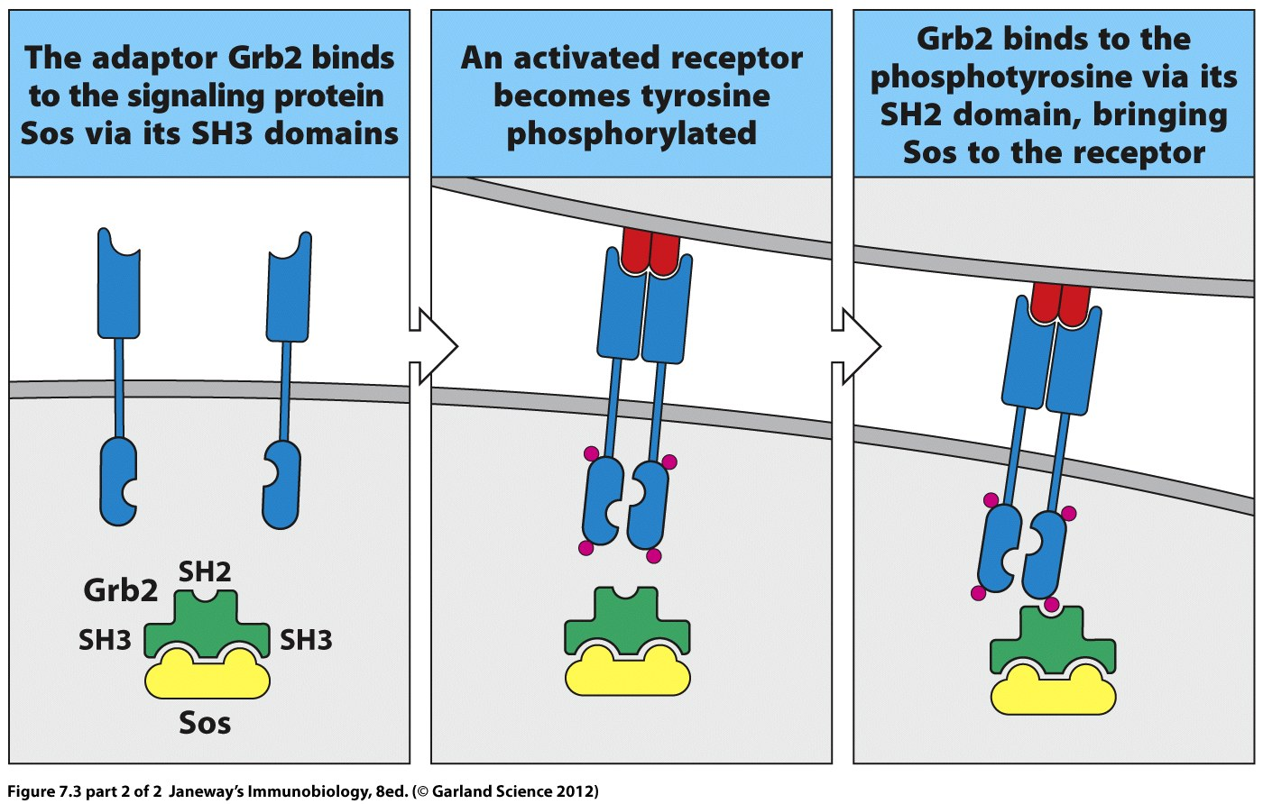

Slide 22
G-proteins
Another important class of signaling molecules are the G-proteins.
Small G proteins/small GTPases
These small membrane-associated proteins exist in 2 states, depending on their interaction with Guanine triphosphate (GTP) or Guanine diphosphate (GDP)

Slide 23
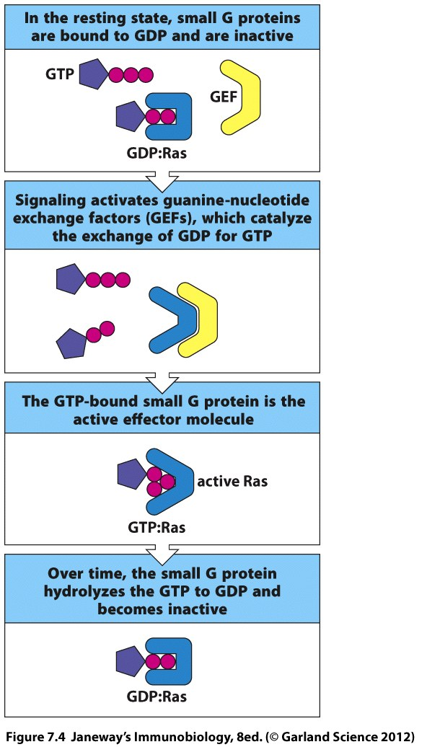

Slide 24
A G-protein called RAS, is one of the most important signaling proteins in cell cycle related signal transduction.
When RAS is abnormally expressed, the cell keeps getting the signal to divide. RAS was one of the first identified oncogenes (cancer-associated) genes.

Slide 25
Lecture 23 Part 2
A third type of system for getting the signal past the cell membrane is by modifying membrane lipids.
Enzymes called phophatidylinosotol kinases (PIPs) add phosphate groups to membrane lipids which in turn attract other signaling molecules.

Slide 26
Let’s summarize…Once a cell binds to a signal from the outside of the cell membrane…How does the nucleus eventually “receive” the signal and begin expressing new genes?

Slide 27
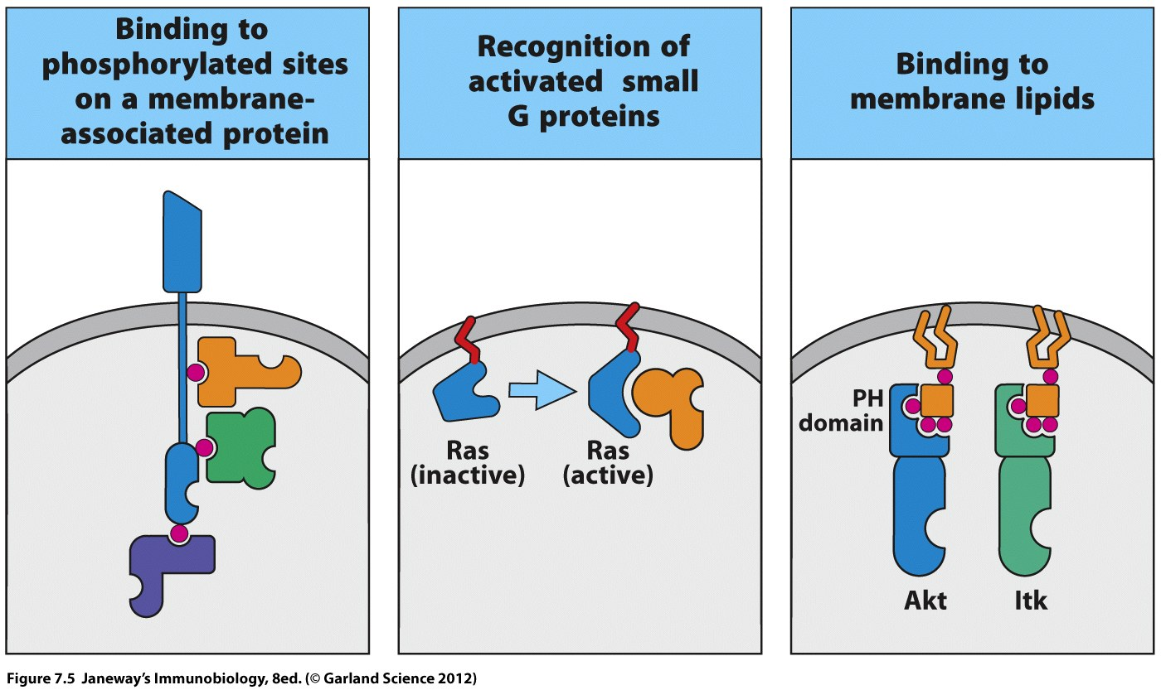

Slide 28
Intermediate steps
As the “signal” moves inward from the plasma membrane, the receptor-associated proteins hand off to molecules called---second messengers.
Calcuim ions can serve as second messengers
Many proteins that successively phosphorylate are second messengers. Raf, Mek, Erk

Slide 29
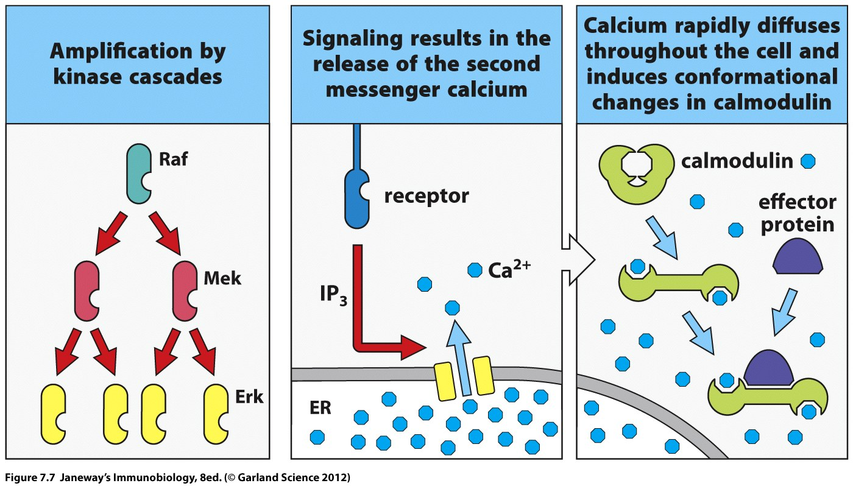

Slide 30
How does the signal finally get to the nucleus and affect gene expression?
Later signal proteins eventually enter the nucleus and act as transcription initiators (or repressors).

Slide 31
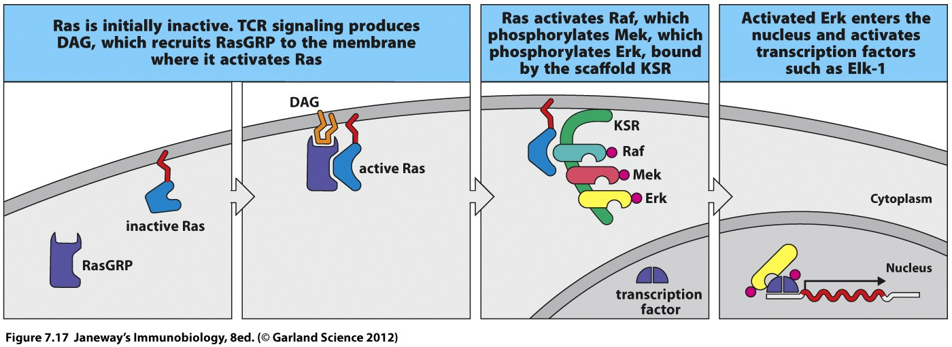
Examples?
Phosphorylation of Erk allows it to enter the nucleus and activate transcription factors

Slide 32
More examples
Calcium ions also promote the dephosphorylation of a protein NFAT which allows it to enter the nucleus.
There it acts directly as a transcription activator.

Slide 33
More examples
Signaling through RAS (G-protein) leads to activation of several important TFs
NFkB
AP1 (a heterodimer of Fos and Jun proteins)

Slide 34
NFkB is normally held in the cytoplasm by an inhibitor.
A late step in signal transduction strips away and degrades the inhibitor.

Slide 35
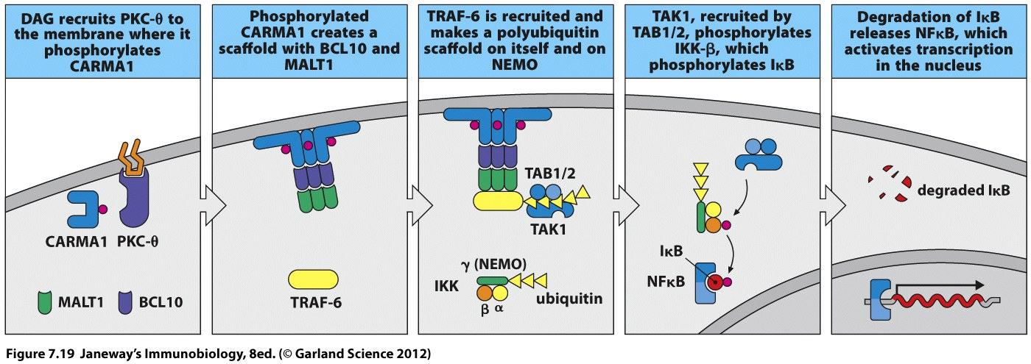

Slide 36
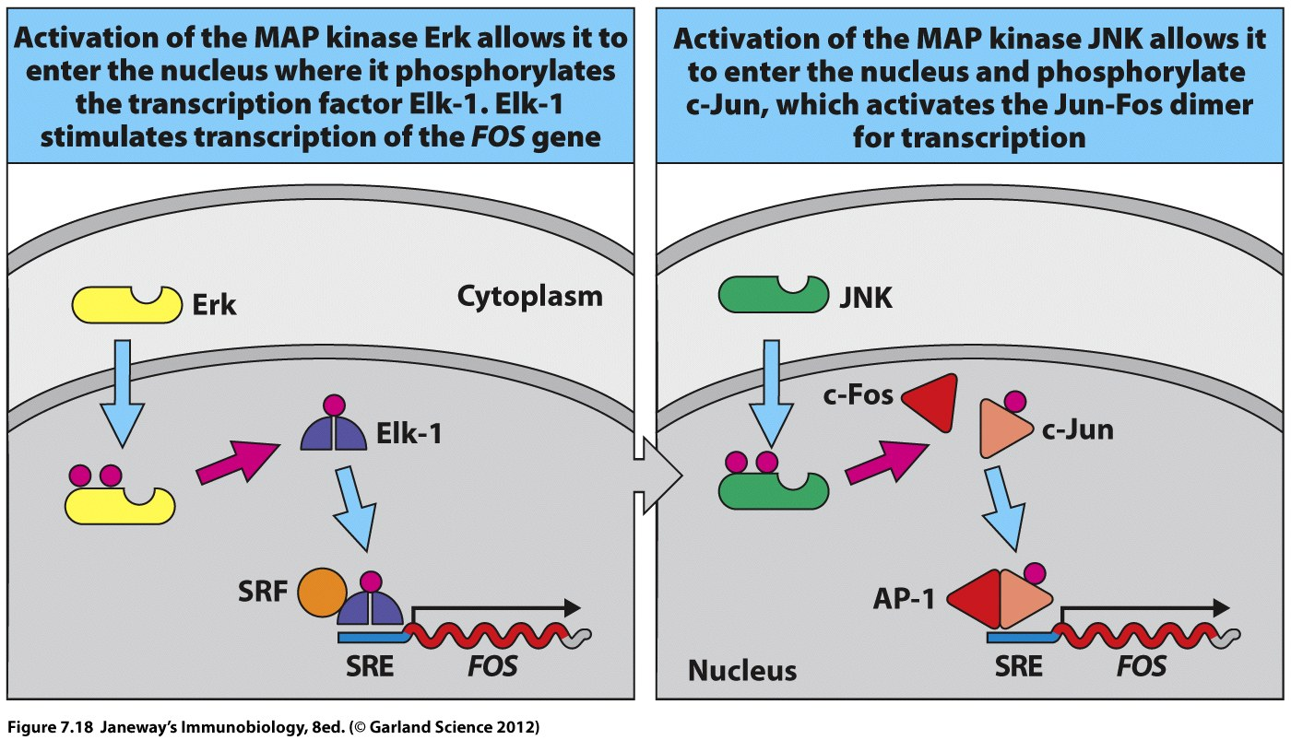

Slide 37
The next slide summarized some of the transcription activators that can turn on the IL-2 gene.

Slide 38
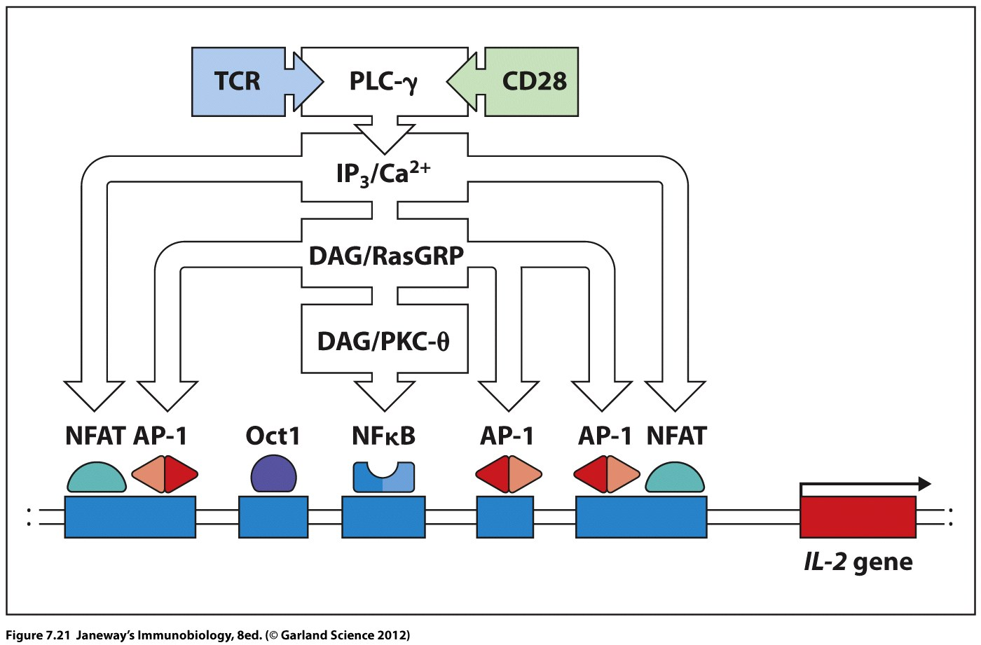

Slide 39
We can now start to think more directly about some immune system events as signal transduction pathways.
For example…TCR binding to TCR ligand starts the very important signal to activate the T-cell.

